Slide 1

Attendance Tracker
Streamlining Classroom Management with Real-Time Technology

Slide 2

The Problem
Manual Methods Waste Time
Traditional attendance systems consume precious class time and introduce human error. Paper sheets get lost, handwriting is illegible, and data entry takes minutes that could be spent teaching.
Students forget to sign in, teachers duplicate entries, and tracking becomes a logistical nightmare by semester's end.

Slide 3
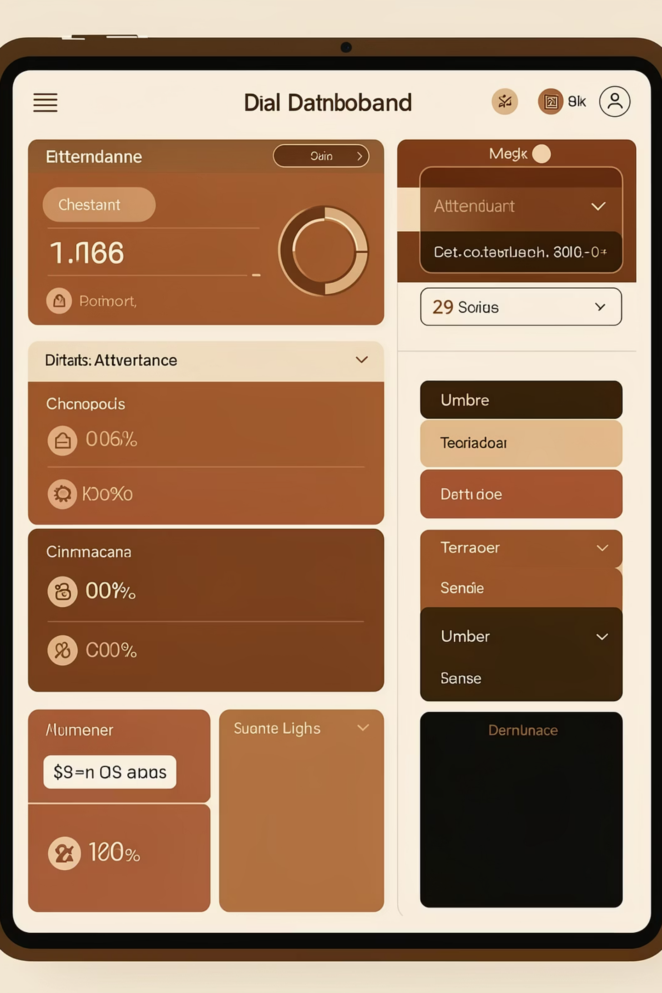

The Solution
A web-based Single Page Application that transforms attendance tracking into a seamless, automated experience. Built with modern technology for maximum speed and security.
Lightning Fast
Secure Access
Track 30 students in under 10 seconds
Role-based authentication prevents fraud
Smart Analytics
Visual dashboards reveal patterns instantly

Slide 4
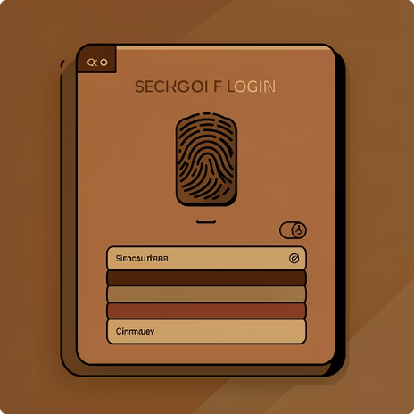

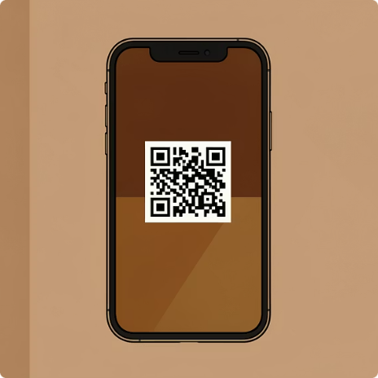
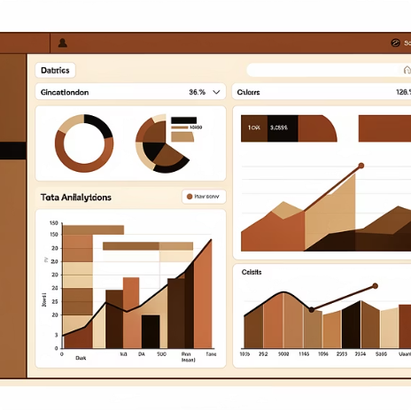
Core Features
Role-Based Access Control
Real-Time Database Sync
Anti-Fraud Security
Visual Analytics Dashboard
Unique session codes and QR validation prevent proxy attendance and ensure authenticity.
Admins, teachers, and students each have tailored dashboards with appropriate permissions and views.
Instant updates ensure everyone sees current attendance status without refreshing pages or waiting.
Graphs and charts transform raw data into actionable insights at a glance.

Slide 5
Technology Stack
Built with Modern Tech
React 18+
Tailwind CSS
Production-ready stack using industry standards
Component-based architecture with hooks for state management and dynamic UI rendering
Utility-first framework enabling rapid, responsive design with modern aesthetics
Vite Build Tool
Cloud Hosting
Lightning-fast development server and optimized production builds
Scalable infrastructure with global CDN for zero-latency access

Slide 6
Admin User Flow
Secure Login
Authenticate with credentials
Create Session
Set class details and time
Generate Code
Launch unique session identifier
Monitor Live
Watch attendance count update
Close Session
Finalize and save records

Slide 7

Student Experience
Simple Three-Step Process
Log in to your student account with your credentials
Enter code or scan the QR displayed in class
Confirm success and view your personal attendance history
Mobile-optimized interface works seamlessly on phones, tablets, and desktops. Students receive instant confirmation and can track their own attendance patterns throughout the semester.

Slide 8

What Sets Us Apart
Zero-Latency Updates
Mobile-First Design
Paperless System
Changes appear instantly across all devices without manual refresh
Optimized for smartphones and tablets used by students daily
Eliminate paper waste while reducing costs and environmental impact

Slide 9

Future Roadmap
01
Geo-Fencing Integration
Automatically verify student location using GPS coordinates
02
Face Recognition
Biometric authentication for ultimate fraud prevention
03
Export Capabilities
Generate reports in Excel, PDF, or CSV formats
04
API Integration
Connect with LMS platforms like Canvas and Blackboard

Slide 10

Ready for Demo
Live Project
Source Code
Questions?
Access our deployed application at [your-deployment-url.com]
Explore our repository on GitHub at [your-github-url]
We're ready to answer your questions and showcase the system

